Slide 1
Project Name : Medicine Side-Effect Analysis
Team 2 Name:- 1) Rukhsar Tamboli
2) Vilas Tade
3) Akshay Ramteke
4) Krushna Ghuge
5) Premkumar Dhanawade
Mentor Name:- Vinod Sir
Date :- 02-June-2021

Slide 2
Business Objective:
This product could be helpful for companies like 1mg to provide detailed rating of the side effects of the product over their site. It could also be helpful for the patients who are buying drugs online to check the side effects of the drugs before buying it.
To predict a drug with zero/least side-effect for the patient based on the reviews and rating .
Current evidences show the advantages of medicine reviews by users for the safe and effective use of medicines. This data set provides the opinions of consumers about their conditions and the medicines that they have used.

Slide 3
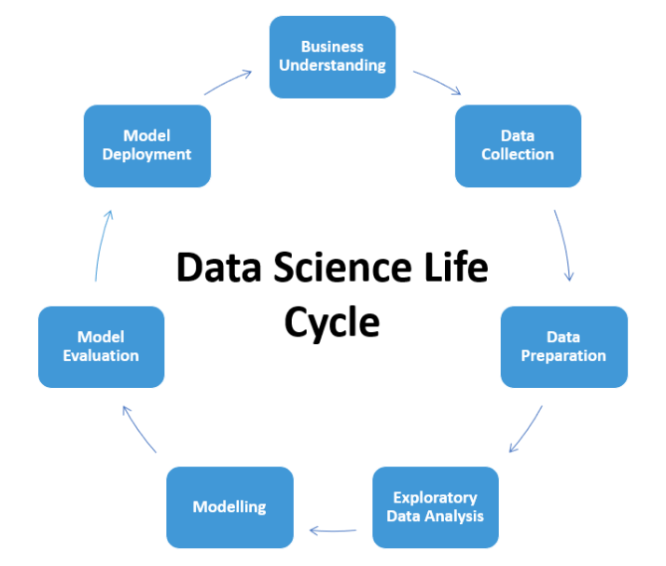
Project Architecture / Project Flow:-

Slide 4
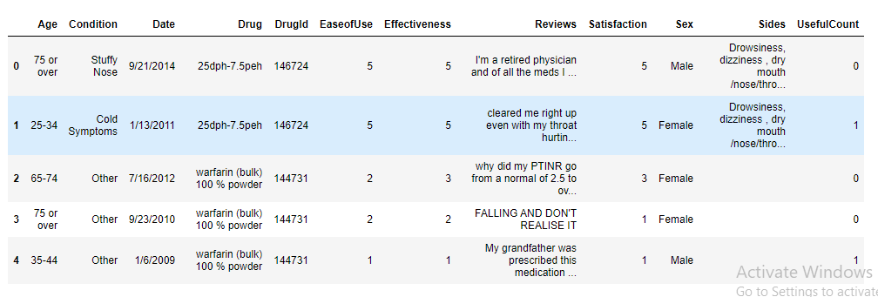
Data Collection Dataset link: https://www.kaggle.com/rohanharode07/webmd-drug-reviews-dataset

Slide 5
Dataset details
362806 rows and 12 column
Year range 2007 to 2020
Unique drug value 7093 and 1805 unique condition
These are the explanations for variables.
1) Age (object) : patient age
2) Condition (object) : name of condition
3) Date (object) : date of review entry
4) Drug (int64) : Name of drug
5) Drug Id (int64) : unique Id of drug
6) EaseofUse (int64) : Ease of use while taking drug
7) Effectiveness (int64) : Effectiveness of drug on patient
8) Reviews (object) : patient Reviews
9) Satisfaction (int64) : rating given by patient out of 10 star
10) Sex (object) : patient gender
11) Sides (object) : patient had side effect after taking drugs
12) UsefulCount (int64) : No. of users who found review useful

Slide 6
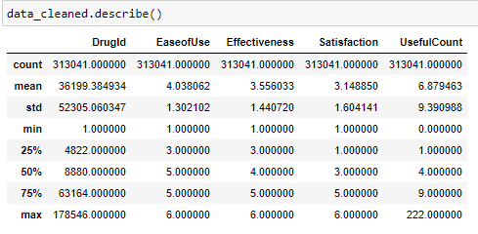
Summary of the Cleaned Dataset

Slide 7
Cleaned Data Details
In Cleaned data we have Female 227691 and Male 85350
We have unique age groups ['75 or over', '25-34', '45-54', '55-64', '19-24', '35-44', '13-18', '65-74', '07-Dec', '0-2', '03-Jun‘]
Cleaned Data set shape (313041, 12) after delete other condition

Slide 8
Exploratory Data Analysis (EDA) & Visualization
Exploratory data analysis is an approach of analyzing data sets to summarize their main characteristics, often using statistical graphics and other data visualization methods.
Visualization is any technique for creating images, diagrams, or animations to communicate a message.

Slide 9
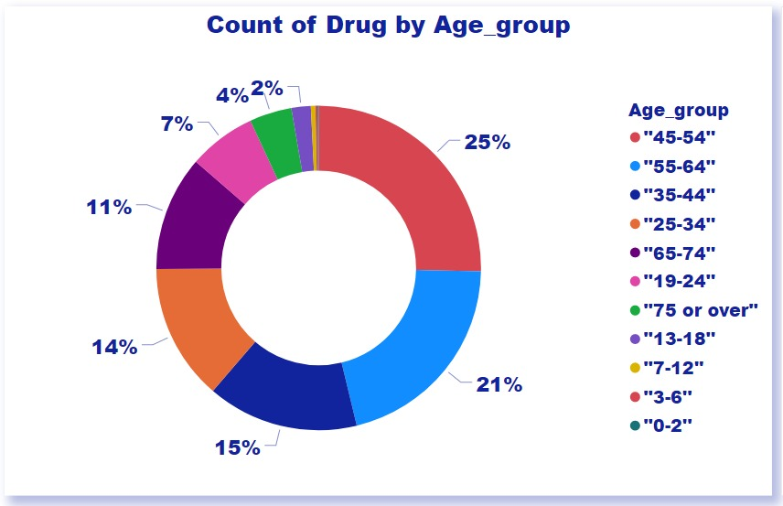

Slide 10
Count of Drug by Age group
Age group Count Percentage
0-2 341 0.12%
3-6 655 0.22%
7-12 1384 0.47%
13-18 5905 1.92%
19-24 20706 6.14%
25-34 41763 13.60%
35-44 46264 15.07%
45-54 77788 25.33%
55-64 64166 20.90%
65-74 35160 11.45%
75 or over 12938 4.21%

Slide 11
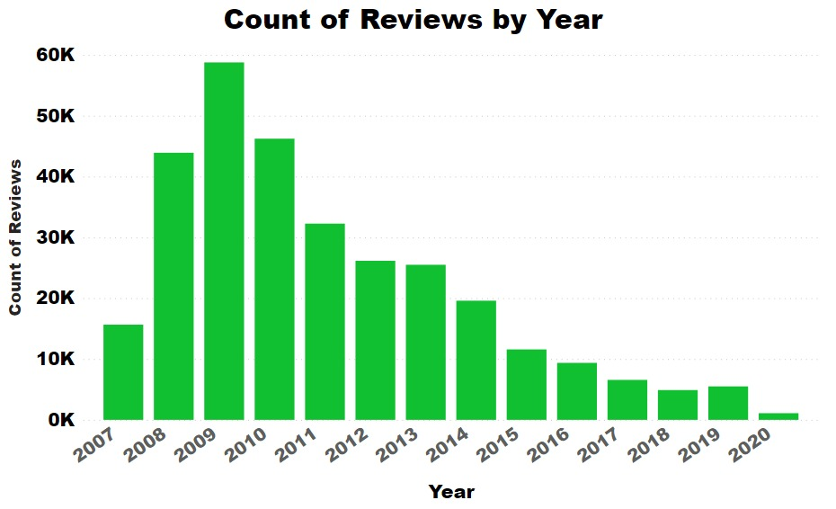
Count of Reviews by Years

Slide 12
Count of reviews by year
Years Count of Reviews
2007 16K
2008 44K
2009 59K
2010 46K
2011 32K
2012 26K
2013 25K
2014 20K
2015 12K
2016 9K
2017 7K
2018 5K
2019 6K
2020 1K

Slide 13
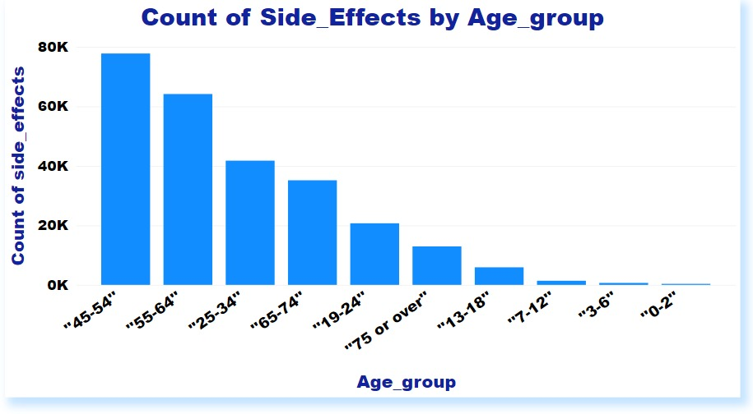
Count of side effect by Age group

Slide 14
Count of side effect by age group
Age Group Count of side effect
0-2 341
3-6 1 K
7-12 1 K
13-18 6 K
75 or over 13 K
19-24 21 K
65-74 35 K
25-34 42 K
55-64 64 K
45-54 78 K

Slide 15
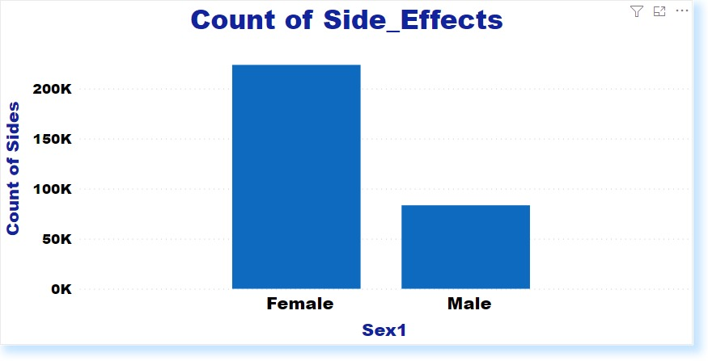
Count of Side Effects
Female :- 223.66 K
Male :- 83.41 K

Slide 16
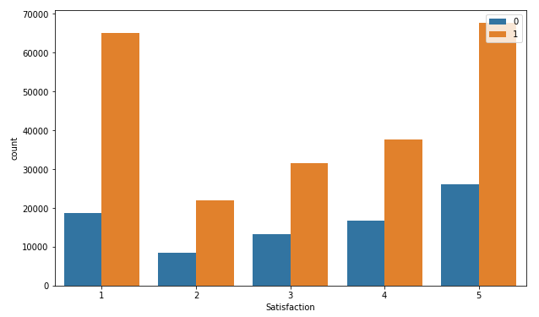
Satisfaction rate
0 for Male
1 for Female
Satisfaction rate out of 5

Slide 17
Python / Lemmatization with NLTK
Lemmatization technique is like stemming. The output we will get after lemmatization is called ‘lemma’, which is a root word rather than root stem, the output of stemming. After lemmatization, we will be getting a valid word that means the same thing.
NLTK provides WordNetLemmatizer class which is a thin wrapper around the wordnet corpus. This class uses morphy () function to the WordNet CorpusReader class to find a lemma.

Slide 18
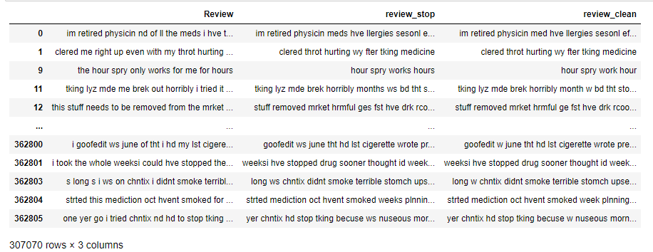
Cleaned Data Review

Slide 19
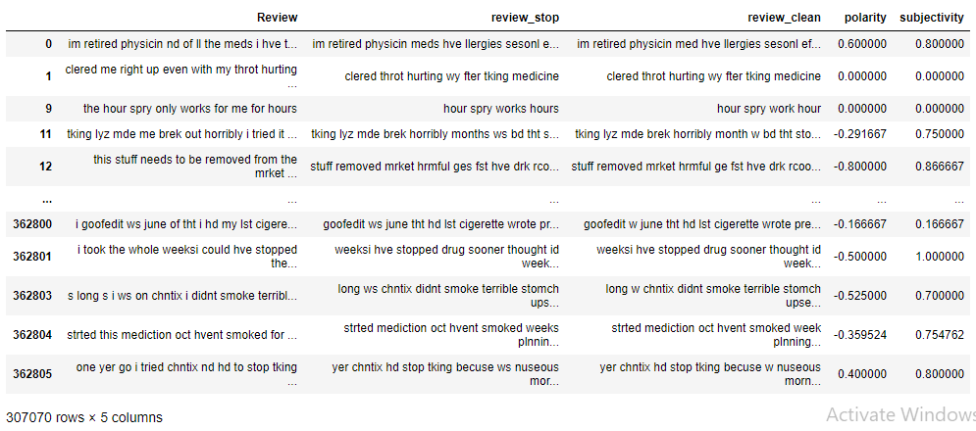
Cleaned Data polarity and subjectivity

Slide 20
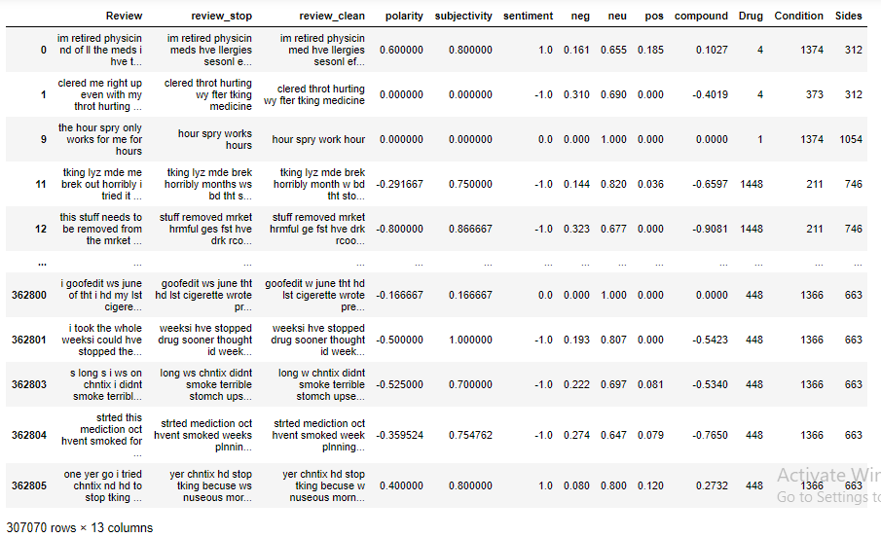
Label Encoding Drugname and Conditions

Slide 21
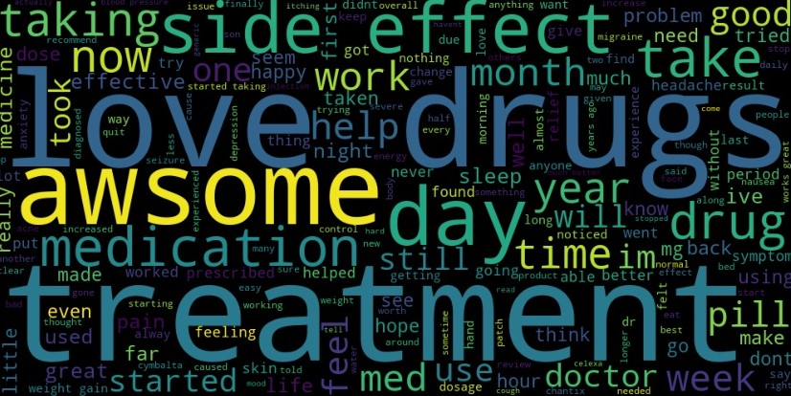
Word cloud of the Clean reviews with +ve sentiments

Slide 22
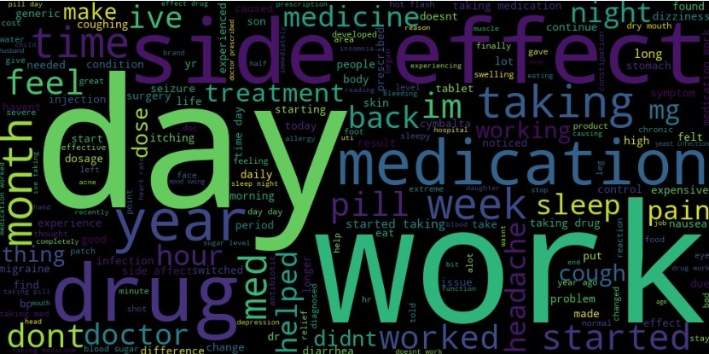
Word cloud of the Clean reviews with neutral sentiments

Slide 23
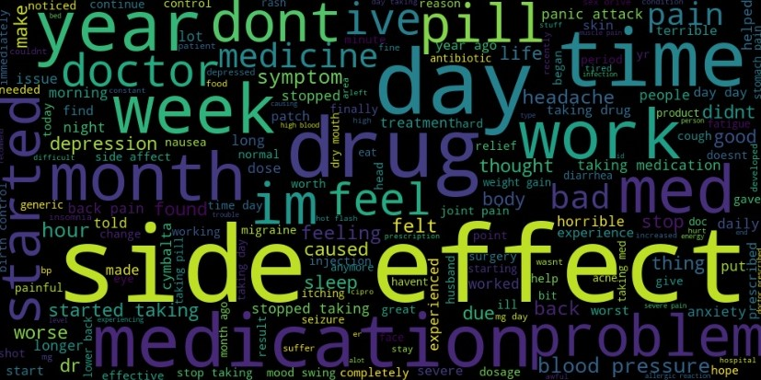
Word cloud of the Clean reviews with -ve sentiments

Slide 24
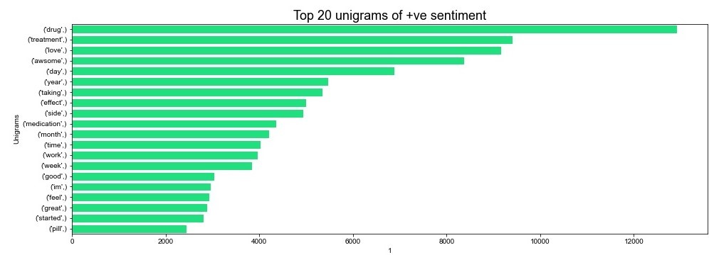
Top 20 unigrams according to the Satisfaction_rating Positive Sentiments

Slide 25
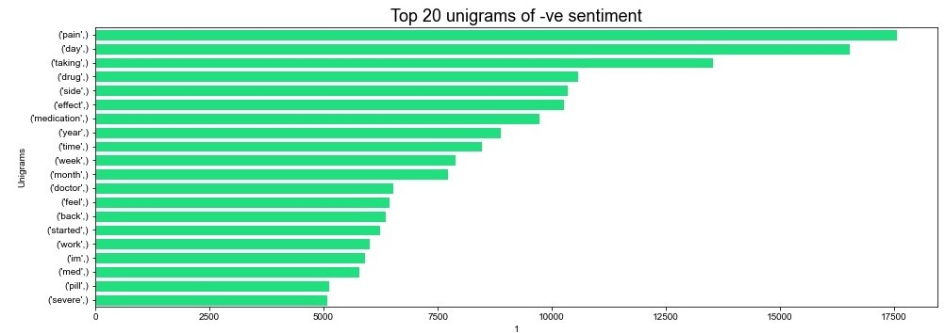
Negative Sentiments

Slide 26
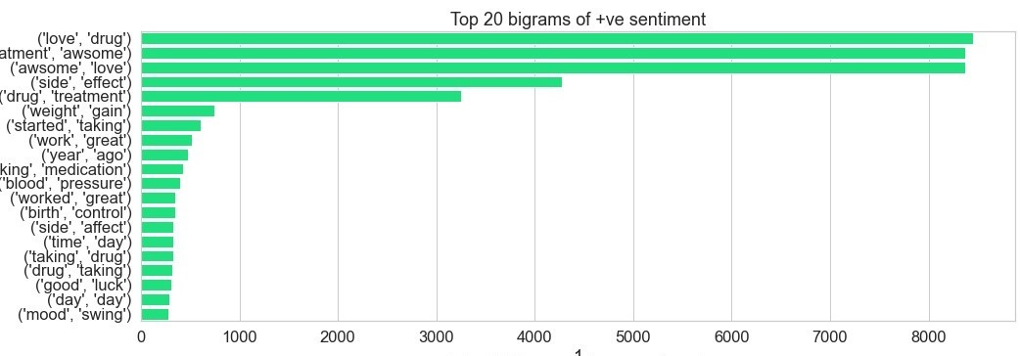
Top 20 bigrams according to the Satisfaction_rating Positive Sentiments

Slide 27
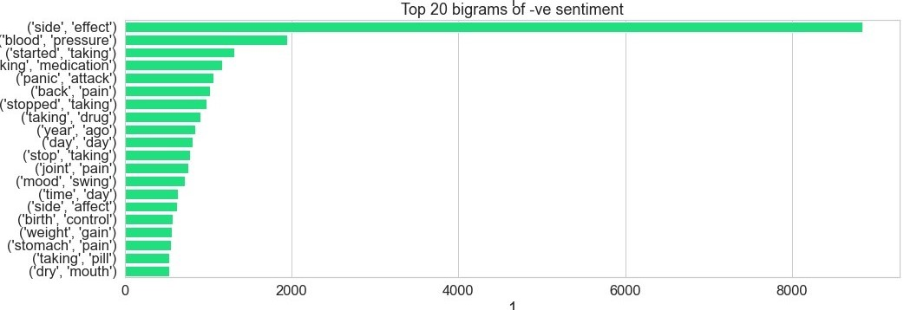
Negative Sentiments

Slide 28
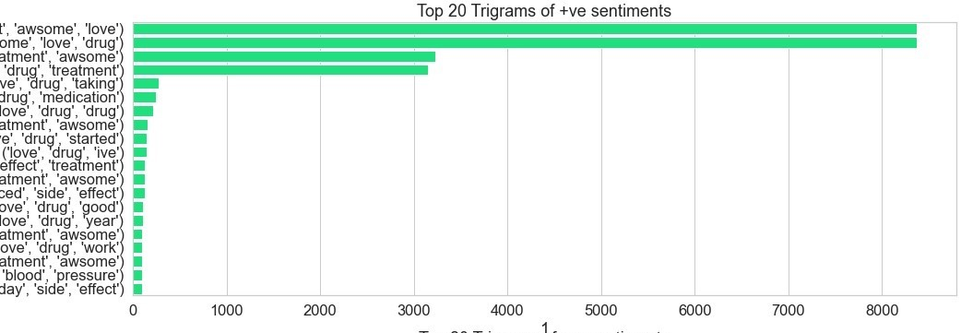
Top 20 Trigrams according to the Satisfaction_rating Positive Sentiments

Slide 29
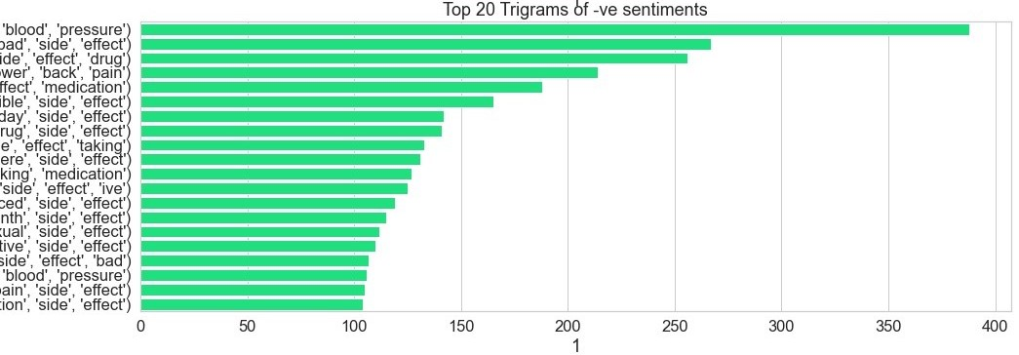
Negative Sentiment

Slide 30
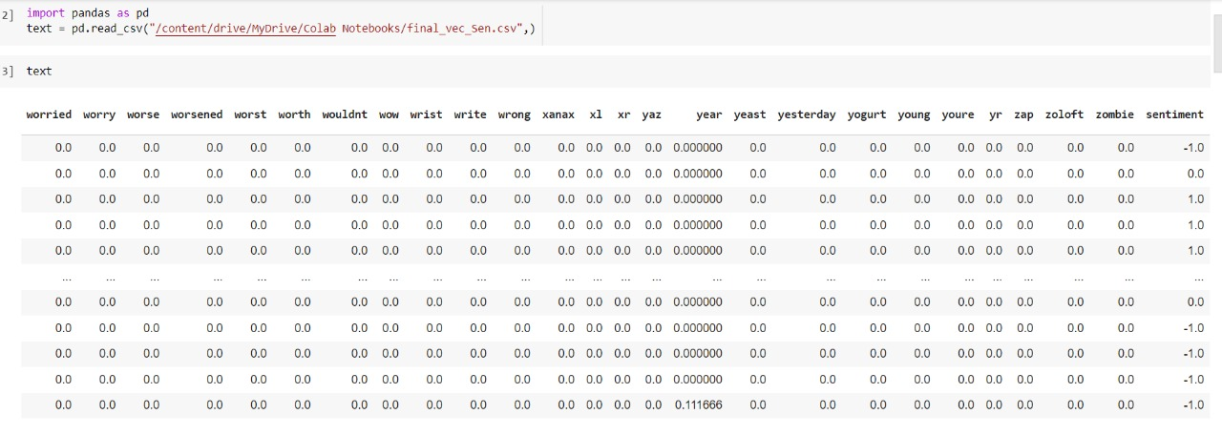
X and Y Features

Slide 31
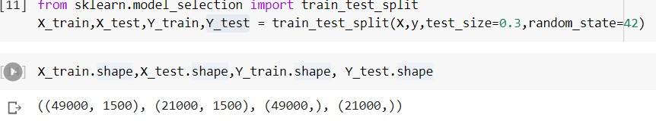
Dataset Details Dataset details(70000,1507) X.shape(70000,1506) Y.shape(70000,1) Split The Data in Train & Test (70:30)

Slide 32
Model Building :-
Sr No | Algorithm Name | Training Accuracy | Testing Accuracy
1 | LGBM Classifier | 97.3591% | 92.5428%
2 | XGB Classifier | 77.4918% | 75.9761%
3 | KNN Classifier | 75.7530% | 64.0428%
4 | Logistic Regression | 91.1224% | 89.4952%
From above the Table we can see the LGBM Classifier Training & Testing model accuracy is 97.3591%& 92.5428% resp.
But we choose the Logistic Regression model to predict our new data.

Slide 33
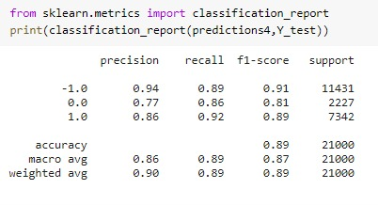
Model Results Presentation :-

Slide 34
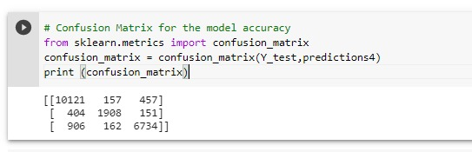
Confusion matrix :-

Slide 35
Model Deployment
The Model Deployed is Logistic Regression with 91.1224% Training Accuracy.
For deployment we have create two files like app.py
Model.pkl and tv_Deployment.pkl file is also created.

Slide 36
Deployment using Flask :-
Flask File creation:
Second file named server.py in this we have import flask
Using @app.route(‘/’) url to execute homepage function which named as home.html
Using @app.route(‘/predict’, methods=[‘post’]) transfer data to server and provide input
After that we have Predict using this link http://127.0.0.1:5000/

Slide 37
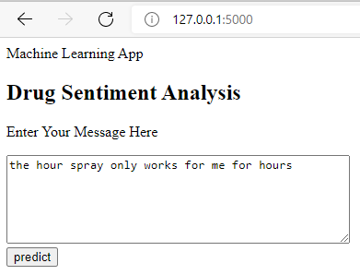
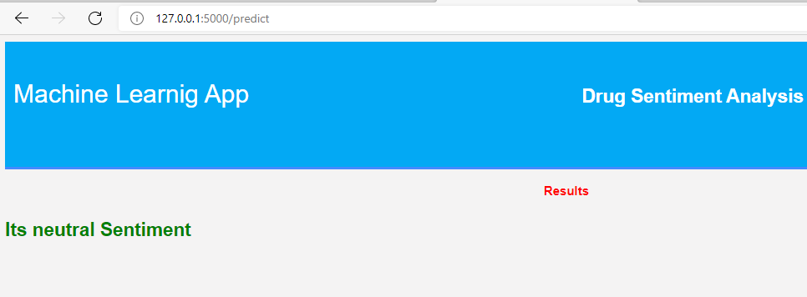
Result :- Input Output

Slide 38
Deployment Using Power BI :-
We are use Sentiment for analyse Reviews.
We are create 2 model for analysis.
1st condition is Condition and
2nd is Drug to analyse
In analysis we create Pie chart, Reviews section, Review wise Emoji sentiment and Side effect.
website link :-https://app.powerbi.com/view?r=eyJrIjoiY2E4YzBkNjMtZGMzMC00NDdjLTg3N2UtNjcwMjg1YzFhZWQ3IiwidCI6ImU5MTNjYWFiLWI3ZjMtNGM5ZS04ZTZkLTVkY2QyYzQyOTlmMiJ9&pageName=ReportSectiona069c2510c8aaebef84a

Slide 39

Power BI
We can see here User interface (UI) with welcome.
Ready to go next page.

Slide 40
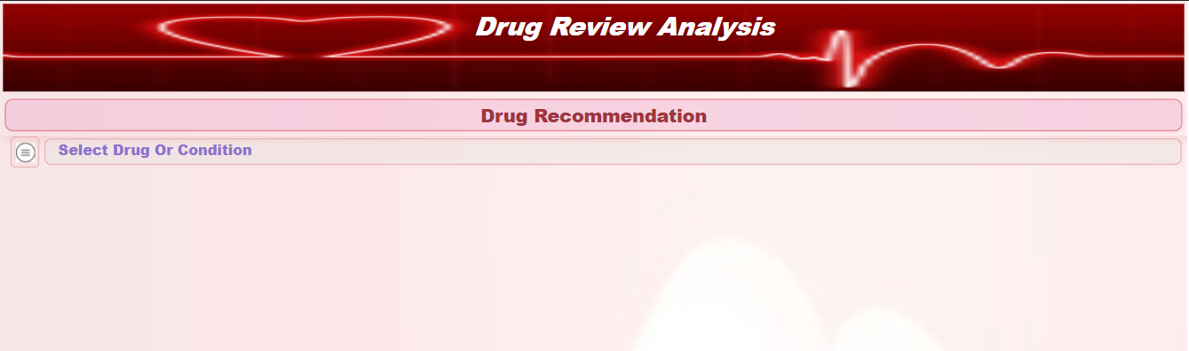
We can see here 1st page of Drug Review Analysis. Then we can see Drug Recommendation block. Then we can click on select Drug OR Condition button.

Slide 41
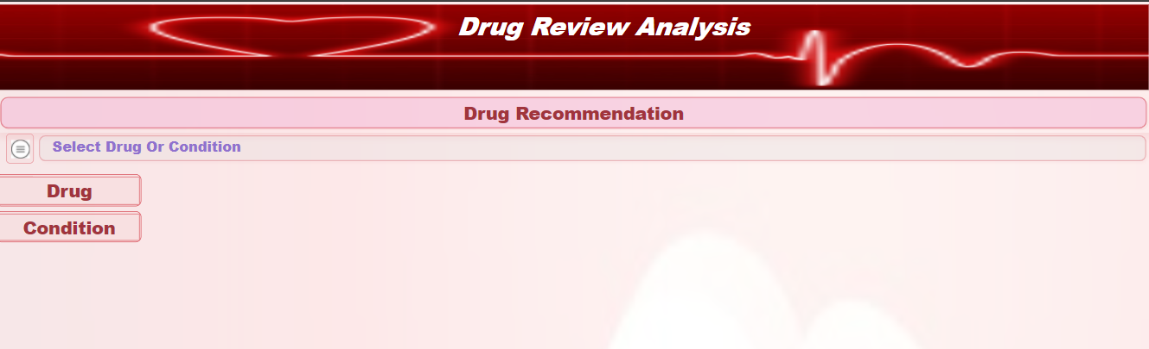
After select Drug Or Condition button . Here we can select Drug button.

Slide 42
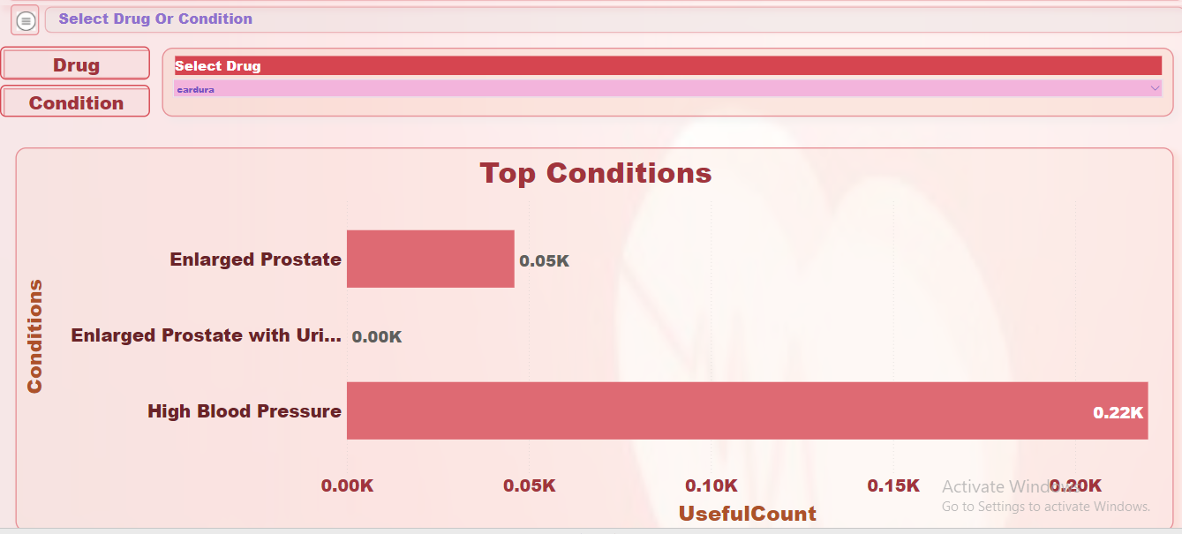
🡪 After click on Drug button we can select any drug or search. Here we can select cardura name drug, then we can see top condition and Useful Count Accordingly.

Slide 43
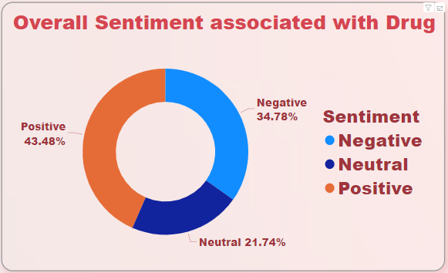
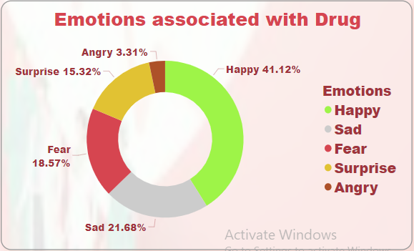
🡪Here we can see in 1st image Overall Sentiment associated with Drug. 🡪and we can see in 2nd image Emotions Associated with Drug.

Slide 44
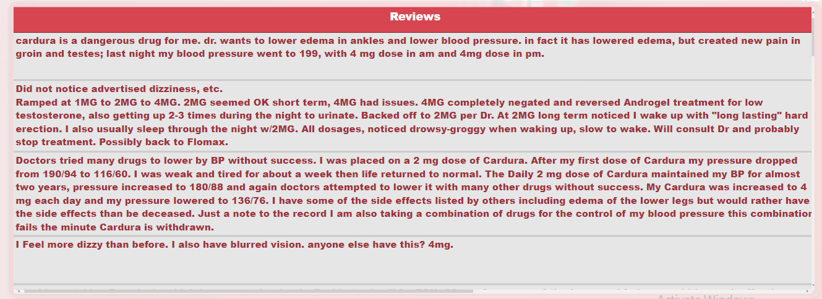
🡪 Here we can see All Reviews for Drug.

Slide 45
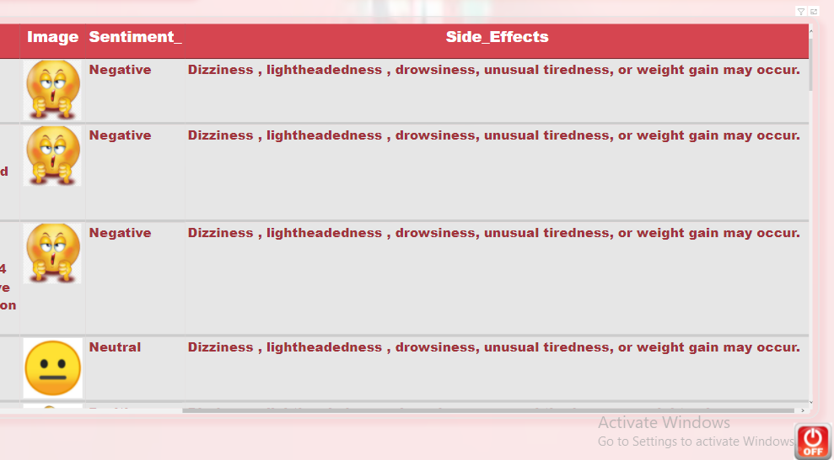
🡪 Here we can see Sentiment and Side Effects of Drug.

Slide 46
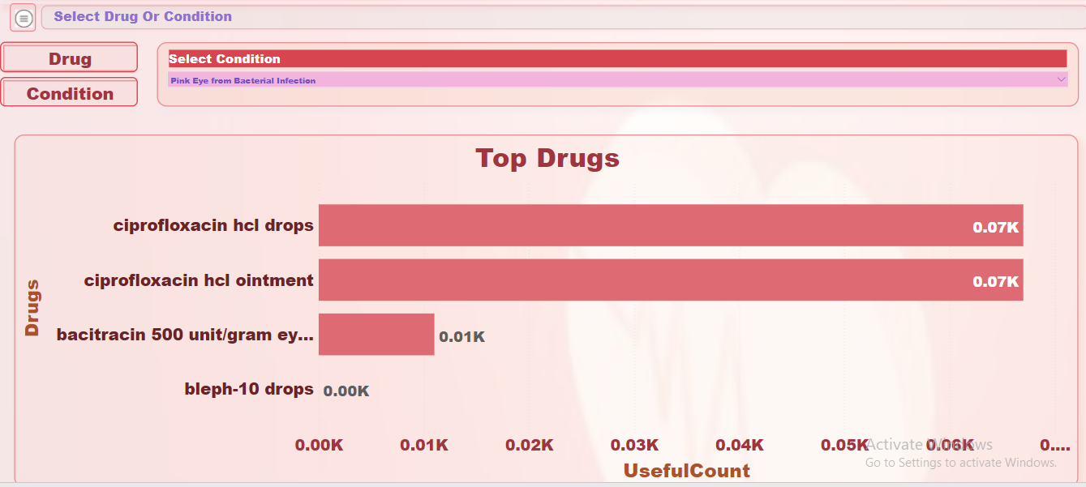
🡪 Here we can click on Condition button, then select condition or search condition. 🡪 here we can select Pink Eye from bacterial Infection condition. 🡪 here we can see Top Drugs And Useful Count for Condition.

Slide 47
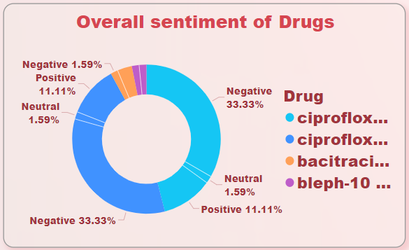
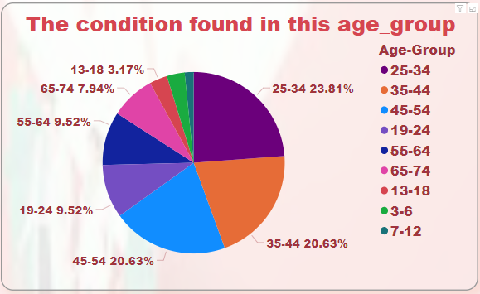
🡪 Here we can see in 1st image Overall Sentiment of Drugs. 🡪 And we can see in 2nd image The condition found in this age group.

Slide 48
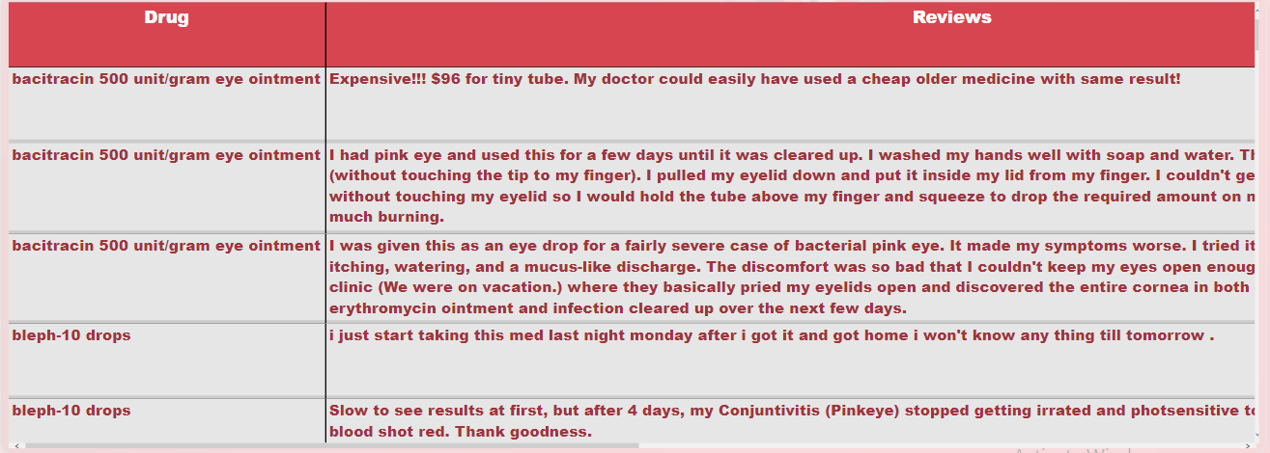
🡪 Here we can see Drug name and Review for Condition.

Slide 49
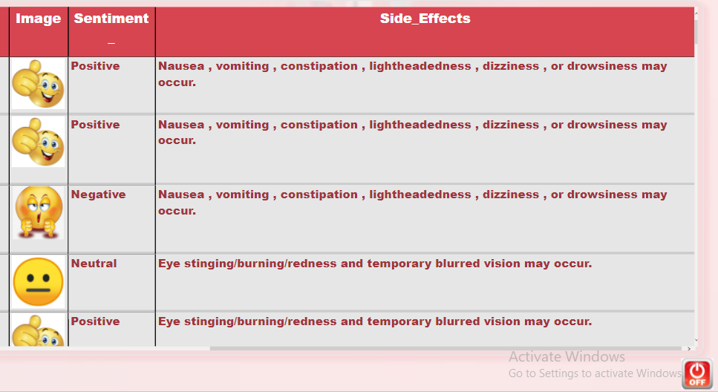
🡪 Here we can see Sentiment And Side effects of Drugs for given Condition.

Slide 50
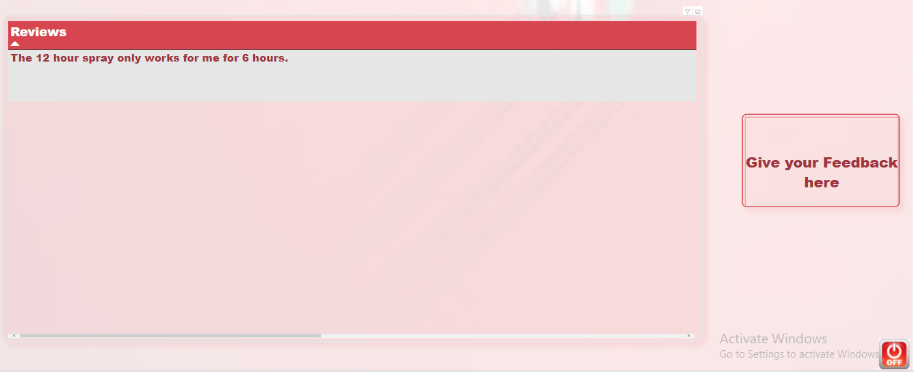
Feedback button

Slide 51
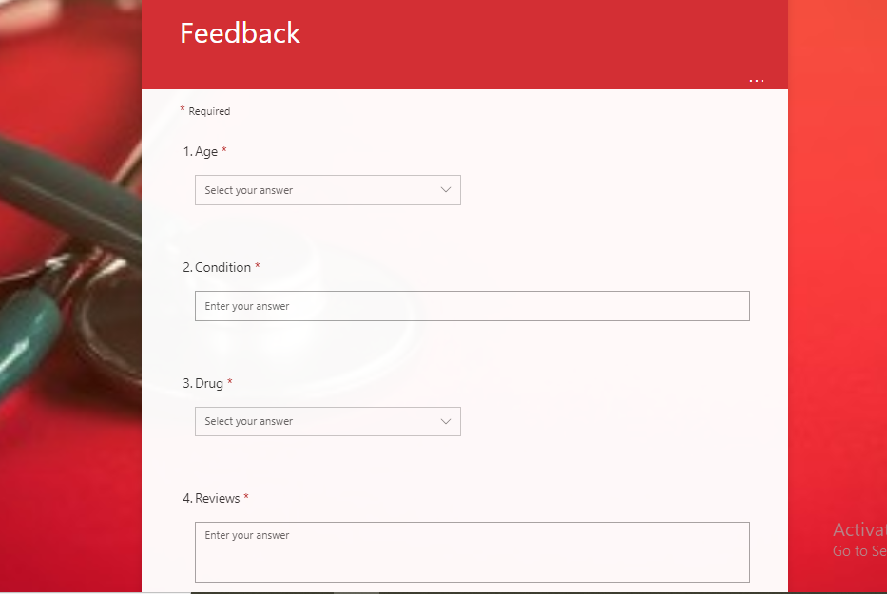
Feedback Form

Slide 52
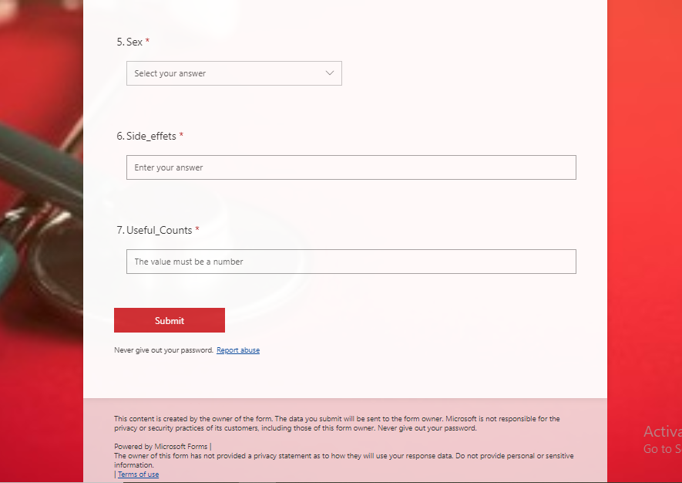

Slide 53
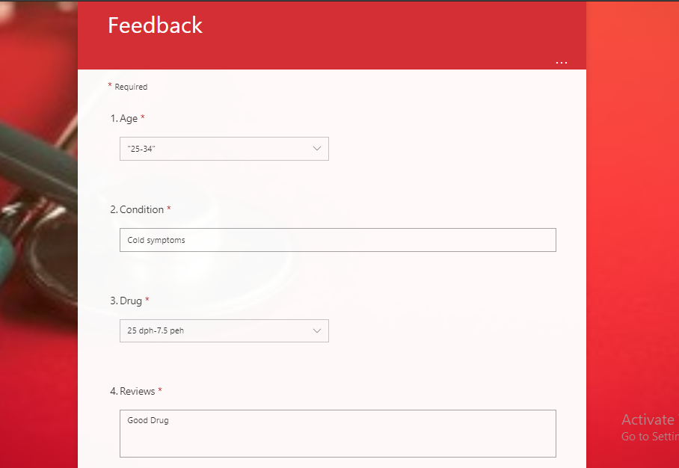
Feel Feedback Form

Slide 54
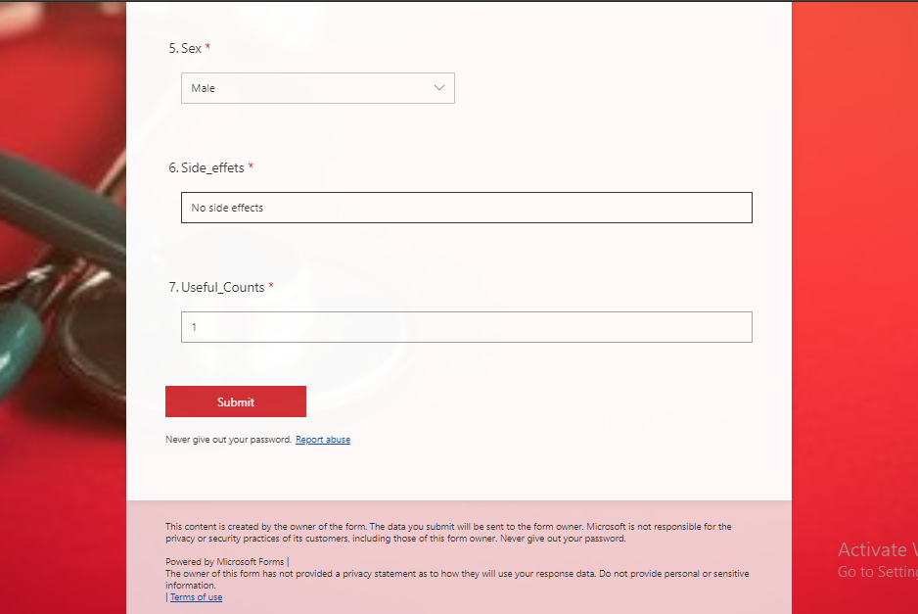
🡪 As we feel feedback form , automatically show Review in the Dashboard.

Slide 55
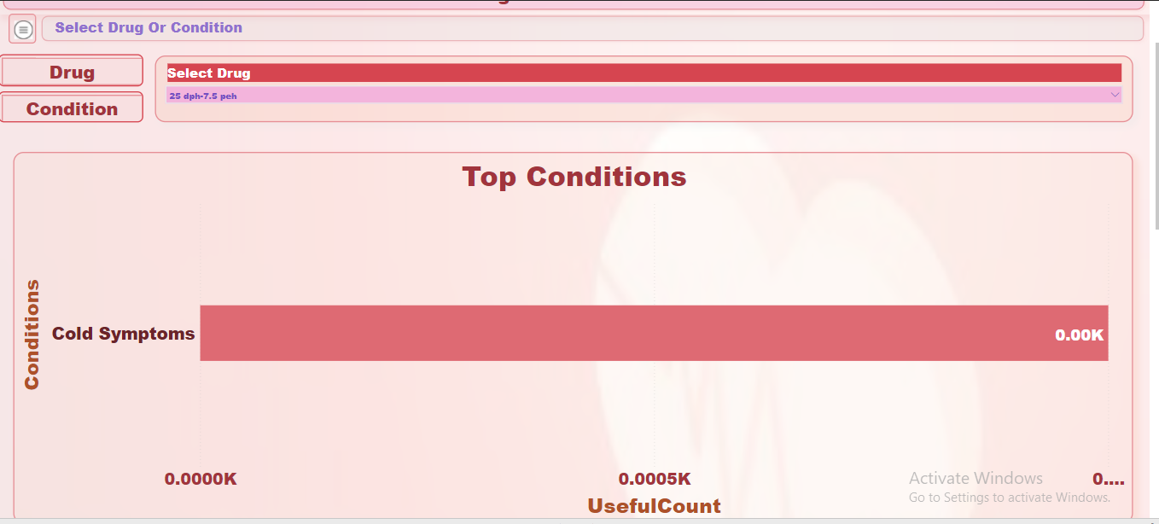
🡪 Here we see same drug name and condition , which feel in feedback form.

Slide 56
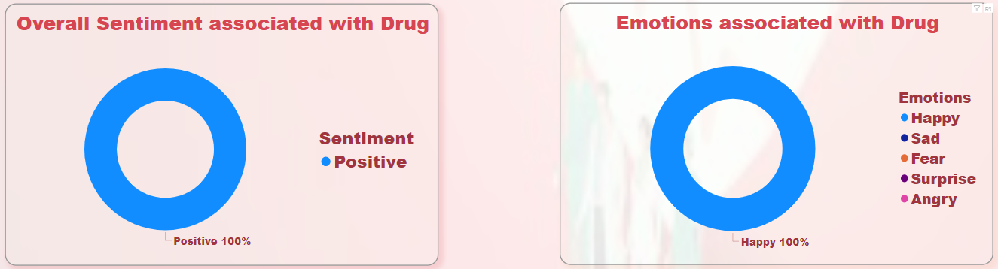
🡪 Here we can see sentiment and Emotion as per we feel in feedback form.

Slide 57
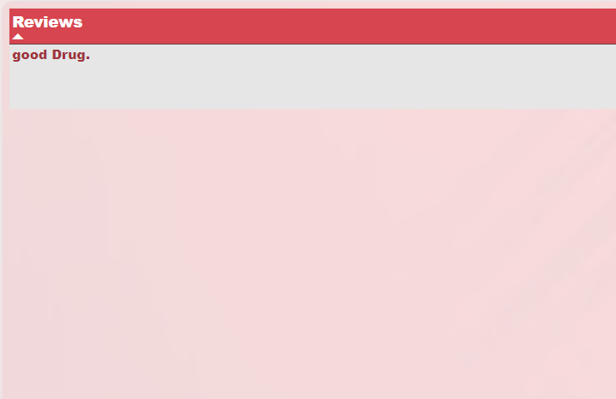
🡪 Here we can see reviews which feel in feedback form.

Slide 58
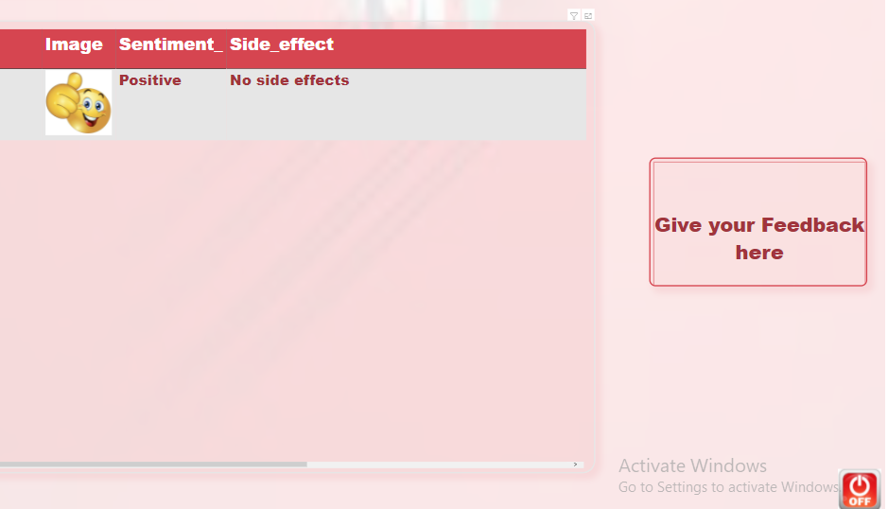
🡪 Here we can see emoji, sentiment and side effect as we feel in feedback form.

Slide 59
Thank You

